Slide 1
The Functional Neural Process Accepted in Neurips 2019
Kyeong Ryeol, Go
M.S. Candidate of OSI Lab

Slide 2
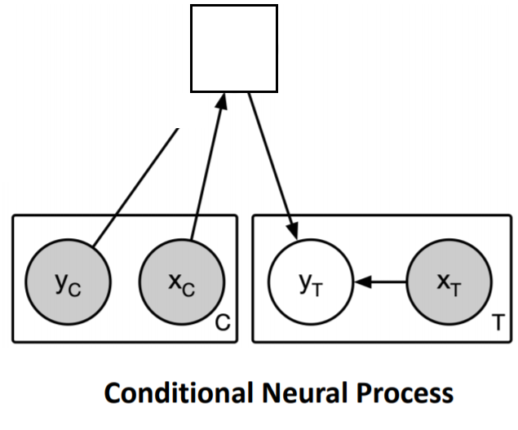
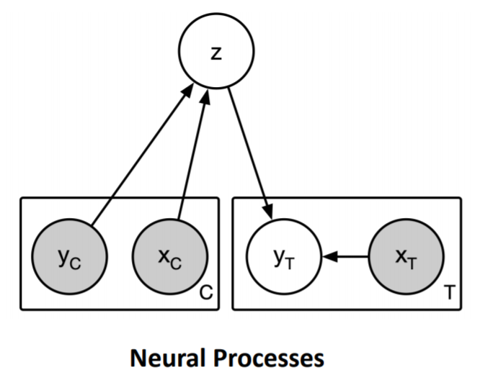
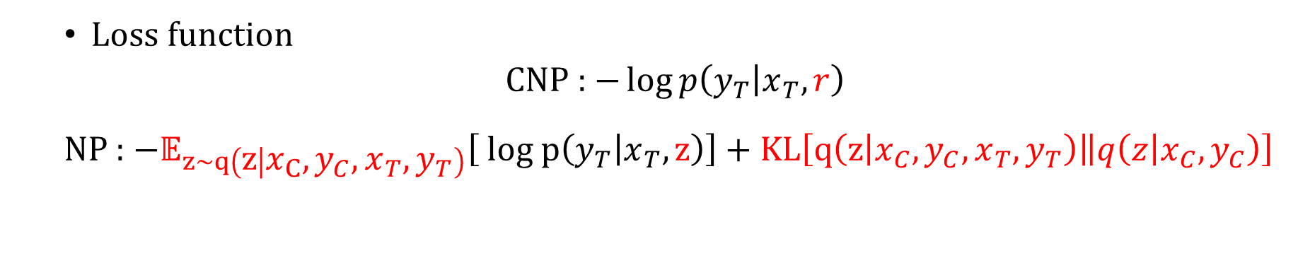
Family of Neural Processes
Devise a neural network based Gaussian process
Enables fast adaptation by the prior knowledge from the portion of the data
r
Loss function
CNP : $−\log{p\left(y_{T} | x_{T},r\right)}$
NP : $−𝔼_{z\sim q\left(z | x_{C}, y_{C}, x_{T}, y_{T}\right)}\left[ log p\left(y_{T} | x_{T}, z\right)\right]+KL\left[\left.q\left(z | x_{C},y_{C},x_{T}, y_{T}\right)\right\|q\left(z | x_{C},y_{C}\right)\right]$

Slide 3
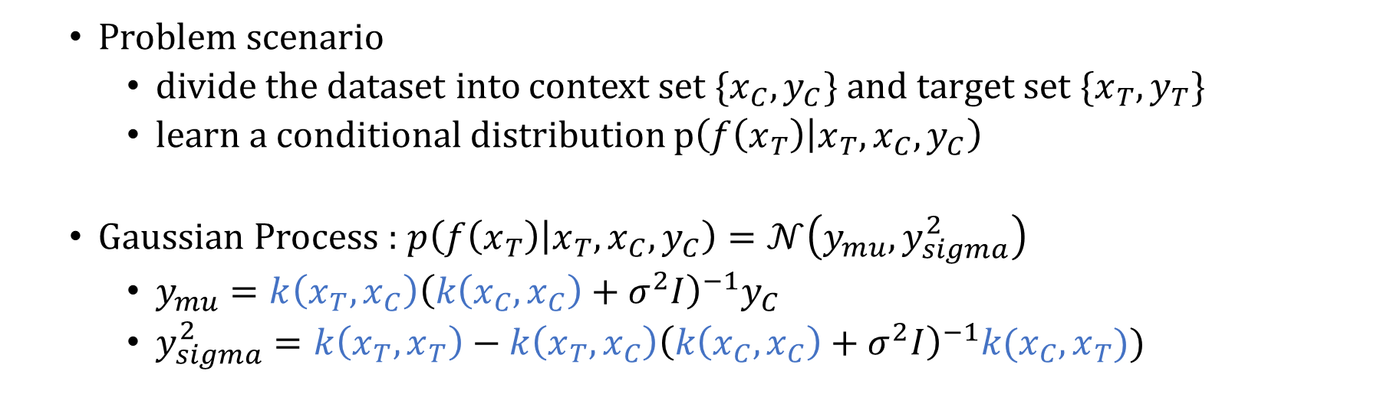
continued
Problem scenario
divide the dataset into context set $\{x_{C}, y_{C}\}$ and target set $\{x_{T}, y_{T}\}$
learn a conditional distribution $p\left(f\left(x_{T}\right) | x_{T}, x_{C}, y_{C}\right)$
Gaussian Process : $p\left(f\left(x_{T}\right) | x_{T},x_{C},y_{C}\right)=𝒩\left(y_{mu}, y_{sigma}^{2}\right)$
$y_{mu}=k\left(x_{T},x_{C}\right){\left(k\left(x_{C},x_{C}\right)+σ^{2}I\right)}^{−1}y_{C}$
$y_{sigma}^{2}=k\left(x_{T}, x_{T}\right)−k\left(x_{T},x_{C}\right){\left(k\left(x_{C}, x_{C}\right)+σ^{2}I\right)}^{−1}k(x_{C},x_{T}))$
Scalability : computation scales linearly in NP
Flexibility : A wide variety of family of distribution can be defined
Permutation invariance : target predictions are order invariant in the contexts

Slide 4
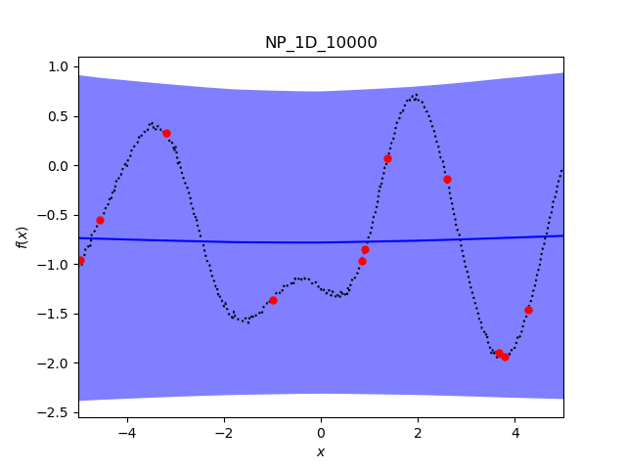
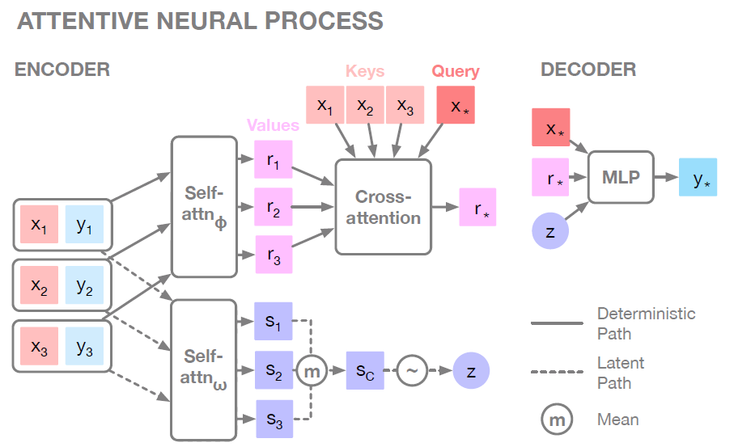
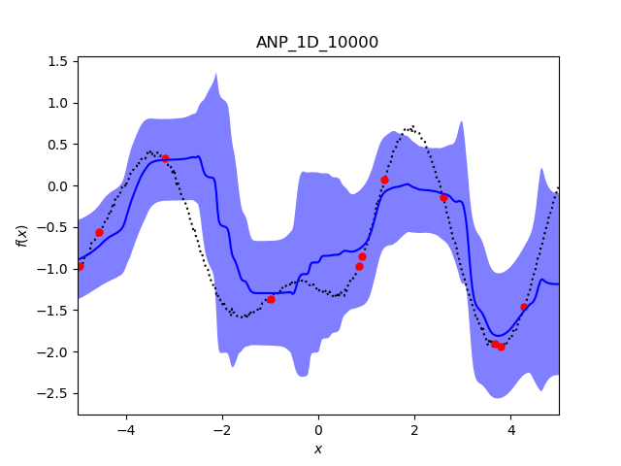
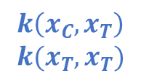
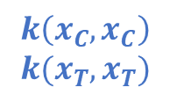
continued
$$k\left(x_{C},x_{C}\right) \\ k(x_{T}, x_{T})$$
$$k\left(x_{C},x_{T}\right) \\ k(x_{T}, x_{T})$$
“Considering the dependency of the data points are significant”

Slide 5
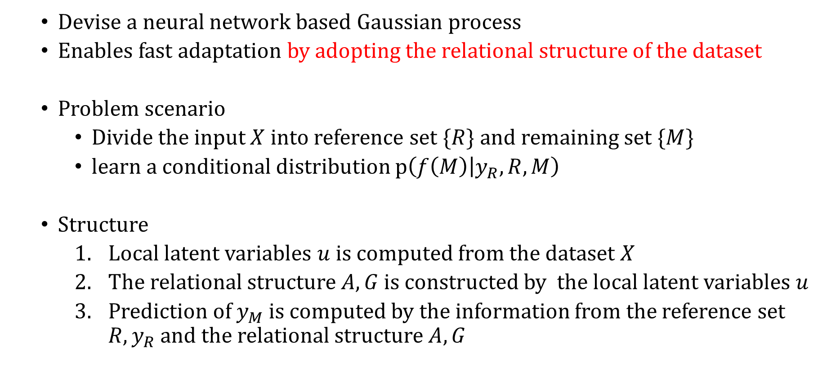
The Functional Neural Process
Devise a neural network based Gaussian process
Enables fast adaptation by adopting the relational structure of the dataset
Problem scenario
Divide the input $X$ into reference set $\{R\}$ and remaining set $\{M\}$
learn a conditional distribution $p\left(f\left(M\right) | y_{R}, R,M\right)$
Structure
Local latent variables $u$ is computed from the dataset $X$
The relational structure $A,G$ is constructed by the local latent variables $u$
Prediction of $y_{M}$ is computed by the information from the reference set $R,y_{R}$ and the relational structure $A,G$

Slide 6
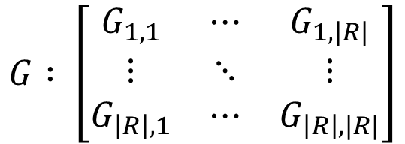
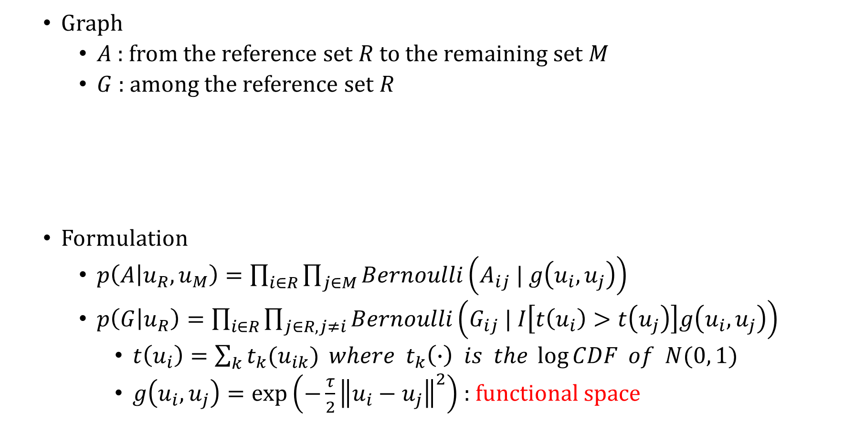
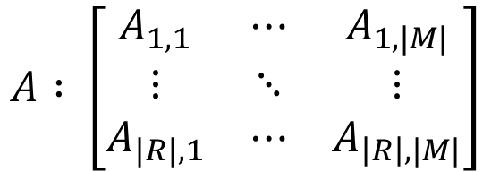
Relational structure
Graph
$A$ : from the reference set $R$ to the remaining set $M$
$G$ : among the reference set $R$
Formulation
$p\left(A | u_{R}, u_{M}\right)=\prod_{i∈R}{\prod_{j∈M}{Bernoulli\left(A_{ij} | g\left(u_{i},u_{j}\right)\right)}}$
$p\left(G | u_{R}\right)=\prod_{i∈R}{\prod_{j∈R,j≠i}{Bernoulli\left(G_{ij} | I\left[t\left(u_{i}\right)>t\left(u_{j}\right)\right]g\left(u_{i},u_{j}\right)\right)}}$
$t\left(u_{i}\right)=\sum_{k}{t_{k}(u_{ik})} where t_{k}\left(∙\right) is the \log{CDF} of N(0, 1)$
$g\left(u_{i},u_{j}\right)=\exp\left(−\frac{τ}{2}{\left\|u_{i}−u_{j}\right\|}^{2}\right)$ : functional space
$$A : \left[\begin{matrix}A_{1,1} & ⋯ & A_{1,|M|} \\ ⋮ & ⋱ & ⋮ \\ A_{|R|,1} & ⋯ & A_{\left|R\right|,|M|}\end{matrix}\right]$$
$$G : \left[\begin{matrix}G_{1,1} & ⋯ & G_{1,|R|} \\ ⋮ & ⋱ & ⋮ \\ G_{\left|R\right|,1} & ⋯ & G_{\left|R\right|,|R|}\end{matrix}\right]$$

Slide 7
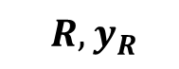
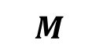
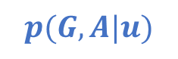
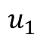
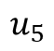
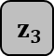
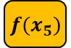
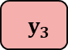

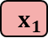
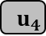

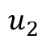
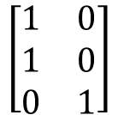
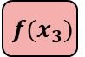
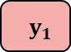
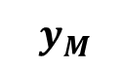
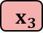
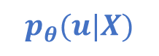
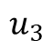
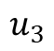
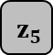
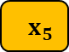
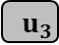
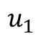
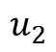
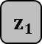
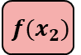
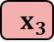
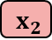
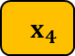
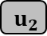
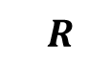
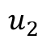


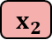
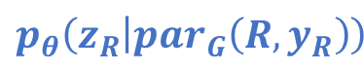
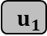
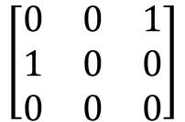
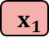










continued
Encoder
Decoder
$$u_{1}$$
$$u_{2}$$
$$u_{3}$$
$$u_{4}$$
$$u_{5}$$
$$y_{R}$$
$$y_{M}$$
$$u_{1}$$
$$\left[\begin{matrix}0 & 0 & 1 \\ 1 & 0 & 0 \\ 0 & 0 & 0\end{matrix}\right]$$
$$u_{1}$$
$$\left[\begin{matrix}1 & 0 \\ 1 & 0 \\ 0 & 1\end{matrix}\right]$$
$$u_{2}$$
$$u_{2}$$
$$u_{3}$$
$$u_{3}$$
$$f(x_{1})$$
$$f(x_{2})$$
$$f(x_{3})$$
$$f(x_{4})$$
$$f(x_{5})$$
$$p_{θ}(y|z)$$
$$G$$
$$A$$
$$z_{1}$$
$$z_{2}$$
$$z_{3}$$
$$z_{4}$$
$$z_{5}$$
$$p(G,A|u)$$
$$p_{θ}\left(z_{R} | par_{G}\left(R,y_{R}\right)\right)$$
$$p_{θ}\left(z_{M} | par_{A}\left(R,y_{R}\right)\right)$$
$$u_{1}$$
$$u_{2}$$
$$u_{3}$$
$$u_{4}$$
$$u_{5}$$
$$y_{1}$$
$$y_{2}$$
$$y_{3}$$
$$p_{θ}(u|X)$$
$$x_{1}$$
$$x_{2}$$
$$x_{3}$$
$$x_{1}$$
$$x_{2}$$
$$x_{3}$$
$$x_{4}$$
$$x_{5}$$
$$R, y_{R}$$
$$R$$
$$M$$

Slide 8

Loss function
Marginal likelihood
$\log{p(y|X)}=\log{\sum_{G,A}{\int{p_{θ}(u,G,A,z,y|X)}du dz}}$ $=\log{\sum_{G,A}{\int{p_{θ}\left(u | X\right)p\left(G,A | u\right)p_{θ}\left(z_{R} | par_{G}\left(R,y_{R}\right)\right)p_{θ}\left(z_{M} | par_{A}\left(R,y_{R}\right)\right)p_{θ}\left(y | z\right)}du dz}}$
Variational Learning
Variational distribution : $q_{φ}\left(u, G,A,z | X\right)=p_{θ}\left(u | X\right)p\left(G,A | u\right)q_{φ}\left(z | X\right)$
$\log{p(y|X)}$ $≥E_{q_{φ}\left(u,G,A,z | X\right)}\left[\log{p_{θ}\left(u,G,A,z,y | X\right)}−\log{q_{φ}\left(u, G,A,z | X\right)}\right]$ $=E_{q_{φ}\left(u,G,A,z | X\right)}\left[\log{p_{θ}\left(z_{R} | par_{G}\left(R,y_{R}\right)\right)p_{θ}\left(z_{M} | par_{A}\left(R,y_{R}\right)\right)p_{θ}\left(y | z\right)−\log{q_{φ}\left(z | X\right)}}\right]$ $=E_{p_{θ}\left(u_{R},G | R\right)}\left[E_{q_{φ}\left(z_{R} | R\right)}\left[\log{p_{θ}\left(z_{R} | par_{G}\left(R,y_{R}\right)p_{θ}\left(y_{R} | z_{R}\right)\right)}−\log{q_{φ}\left(z_{R} | R\right)}\right] \right]$ $+E_{p_{θ}\left(u,A | X\right)}\left[ E_{q_{φ}(z_{M}|M)}\left[\log{p_{θ}\left(z_{M} | par_{A}\left(R,y_{R}\right)p_{θ}\left(y_{M}\right|z_{M}\right)}−\log{q_{φ}\left(z_{M} | M\right)}\right]\right]$ $≔L_{R}+L_{M|R}$
To be canceled

Slide 9

Minibatch optimization
$L_{R}$ cannot be decomposed to independent sums due to DAG structure
$L_{M|R}$ can be decomposed to |M| independent sums from its i.i.d. nature
$$Loss=L_{R}+L_{M|R}≈L_{R}+{\hat{L}}_{M|R}$$
$L_{M|R}$ $=E_{p_{θ}\left(u,A | X\right)}\left[ E_{q_{φ}(z_{M}|M)}\left[\log{p_{θ}\left(z_{M} | par_{A}\left(R,y_{R}\right)p_{θ}\left(y_{M}\right|z_{M}\right)}−\log{q_{φ}\left(z_{M} | M\right)}\right]\right]=E_{p_{θ}\left(u_{R} | R\right)}\left[E_{p_{θ}\left(u_{M} | M\right)p\left(A | u_{R},u_{M}\right)q_{φ}(z_{M}|M)}\left[\log{p_{θ}\left(z_{M} | par_{A}\left(R,y_{R}\right)p_{θ}\left(y_{M}\right|z_{M}\right)}−\log{q_{φ}\left(z_{M} | M\right)}\right]\right]$ $≈E_{p_{θ}\left(u_{R} | R\right)}\left[\frac{\left|M\right|}{\left|\hat{M}\right|}\sum_{i=1}^{\left|\hat{M}\right|}{E_{p_{θ}\left(u_{i} | x_{i}\right)p\left(A_{i} | u_{R},u_{i }\right)q_{φ}\left(z_{i} | x_{i}\right)}\left[\log{p_{θ}\left(z_{i } | par_{A_{i}}\left(R,y_{R}\right)p_{θ}\left(y_{i}\right|z_{i}\right)}−\log{q_{φ}\left(z_{i} | x_{i}\right)}\right]}\right]$ $≔{\hat{L}}_{M|R}$

Slide 10






























Implementation strategy
$$L_{R} :E_{p_{θ}\left(u_{R},G | R\right)}\left[E_{q_{φ}\left(z_{R} | R\right)}\left[\log{p_{θ}\left(y_{R} | z_{R}\right)}+\log{p_{θ}\left(z_{R} | par_{G}\left(R,y_{R}\right)\right)}−\log{q_{φ}\left(z_{R} | R\right)}\right] \right] \\ L_{M|R} :E_{p_{θ}\left(u,A | X\right)}\left[ E_{q_{φ}(z_{M}|M)}\left[\log{p_{θ}\left(y_{M}\right|z_{M})}+\log{p_{θ}\left(z_{M} | par_{A}\left(R,y_{R}\right)\right)}−\log{q_{φ}\left(z_{M} | M\right)}\right]\right]$$
Old Decoder
New Decoder
$$y_{R}$$
$$y_{M}$$
$$y_{R}$$
$$y_{M}$$
$$f(x_{1})$$
$$f(x_{2})$$
$$f(x_{3})$$
$$f(x_{4})$$
$$f(x_{5})$$
$$f(x_{1})$$
$$f(x_{2})$$
$$f(x_{3})$$
$$f(x_{4})$$
$$f(x_{5})$$
$$z_{1}$$
$$z_{2}$$
$$z_{3}$$
$$z_{4}$$
$$z_{5}$$
$$p_{θ}(y|z)$$
$$z_{1}$$
$$z_{2}$$
$$z_{3}$$
$$z_{4}$$
$$z_{5}$$
$$p_{θ}\left(z_{R} | par_{G}\left(R,y_{R}\right)\right)$$
$$q_{φ}(z_{R}|R)$$
$$p_{θ}\left(z_{M} | par_{A}\left(R,y_{R}\right)\right)$$
$$q_{φ}(z_{M}|M)$$
$$y_{1}$$
$$y_{2}$$
$$y_{3}$$
$$x_{1}$$
$$x_{2}$$
$$x_{3}$$
$$x_{4}$$
$$x_{5}$$
$$x_{1}$$
$$x_{2}$$
$$x_{3}$$
$$R$$
$$M$$
$$R, y_{R}$$

Slide 11





























Predictive distribution
$p_{θ}\left(y^{∗} | y,X,x_{∗}\right)=\sum_{A^{∗}}{\int{p_{θ}\left(u_{R},u^{∗} | R, x^{∗}\right)p\left(A^{∗} | u_{R},u^{∗}\right)p_{θ}\left(z^{∗},y^{∗} | R,y_{R},A^{∗}\right)}du_{R}du^{∗}dz^{∗}}$
$$u_{1}$$
$$u_{2}$$
$$u_{3}$$
$$u_{4}^{∗}$$
$$u_{5}^{∗}$$
$$u_{1}$$
$$u_{1}$$
$$y_{R}$$
$$y^{∗}$$
$$\left[\begin{matrix}0 & 0 & 1 \\ 1 & 0 & 0 \\ 0 & 0 & 0\end{matrix}\right]$$
$$\left[\begin{matrix}1 & 0 \\ 1 & 0 \\ 0 & 1\end{matrix}\right]$$
$$u_{2}$$
$$u_{2}$$
$$u_{3}$$
$$u_{3}$$
$$f(x_{1})$$
$$f(x_{2})$$
$$f(x_{3})$$
$$f(x_{4}^{∗})$$
$$f(x_{5}^{∗})$$
$$G$$
$$A^{∗}$$
$$z_{3}$$
$$z_{1}$$
$$z_{2}$$
$z_{4}^{∗}$
$$z_{5}^{∗}$$
$$u_{1}$$
$$u_{2}$$
$$u_{3}$$
$$u_{4}^{∗}$$
$$u_{5}^{∗}$$
$$y_{1}$$
$$y_{2}$$
$$y_{3}$$
$$x_{1}$$
$$x_{2}$$
$$x_{3}$$
$$x_{1}$$
$$x_{2}$$
$$x_{3}$$
$$x_{4}^{∗}$$
$$x_{5}^{∗}$$
$$R, y_{R}$$
$$R$$
$$x^{∗}$$

Slide 12


Experiment
1. Toy 1d regression
Dataset
$y_{i}=x_{i}+ϵ+\sin\left(4\left(x_{i}+ϵ\right)\right)+\sin\left(13\left(x_{i}+ϵ\right)\right) where ϵ\sim N\left({0,0.03}^{2}\right)$
$y_{i}=x_{i}^{3}+ϵ where ϵ\sim N(0,9)$
Overconfident inductive bias
Similar behavior
In-between

Slide 13


Experiment
2. Image classification
Dataset
In-distribution (MNIST, CIFAR10) : average predictive entropy($↓$) / test error($↓$)
Out-of-distribution : average predictive entropy($↑$) / area under the ROC curve($↑$)

Slide 14

























Experiment
3. NP vs FNP
FNP still provides robust uncertainty and o.o.d detection is improved
NP’s performance is hurt as o.o.d detection is decreased
$$↑$$
$$↓$$
$$↑$$
$$↓$$
$$↑$$
$$↓$$
$$↑$$
$$↑$$
$$↓$$
$$↓$$
$$↑$$
$$↓$$
$$↑$$
$$↑$$
$$↑$$
$$↓$$
$$↑$$
$$↓$$
$$↓$$
$$↑$$
$$↑$$
$$↓$$

Slide 15





Experiment
4. Graph justification
Semantic structure is captured both in A and G
$$p\left(A | u_{R}, u_{M}\right)$$
$$p\left(G | u_{R}\right)$$

Slide 16
Conclusion
Main idea
Build a graph of dependencies among local latent variables
Strength
No information loss due to global latent variable
Behave similar to Gaussian Process with RBF kernel
Satisfy exchangeability and consistency as a stochastic process

Slide 17


Weakness
Not easily transferable comparing to the conventional neural processes
Boost the learning if nice representation can be learned
Helps exploration strategy in reinforcement learning task
Maze exploration
Application on DQN

Slide 18



Weakness
Not scalable when large reference set is required
Time complexity : $O\left(n+m\right)→O\left(nm\right)$
What about ANP? $O\left(n(n+m)\right)$

Slide 19
Weakness
No reasonable or theoretical rule for choosing reference set
Greedy selection, Variational learning of pseudo input
Ex. Bayesian GP-LVM, Deep gaussian process, Set-transformer

Slide 20
Thank you for the attention

